Slide 1
Natural Gas: past and future
Hossein Abbasi
Spring 2021

Slide 2
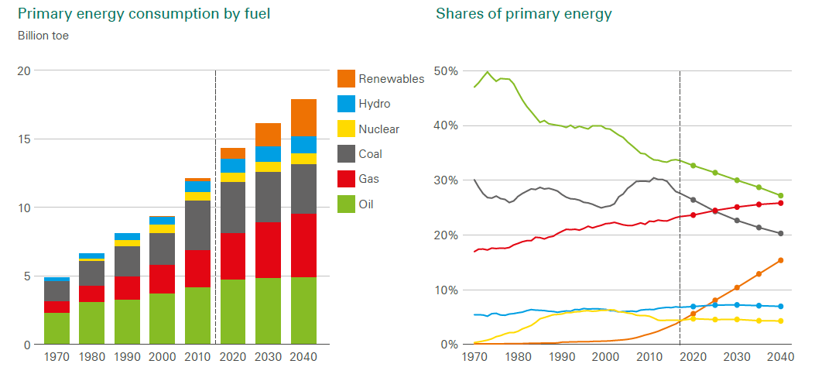
Global consumption of energy by fuel
Source: BP energy outlook

Slide 3
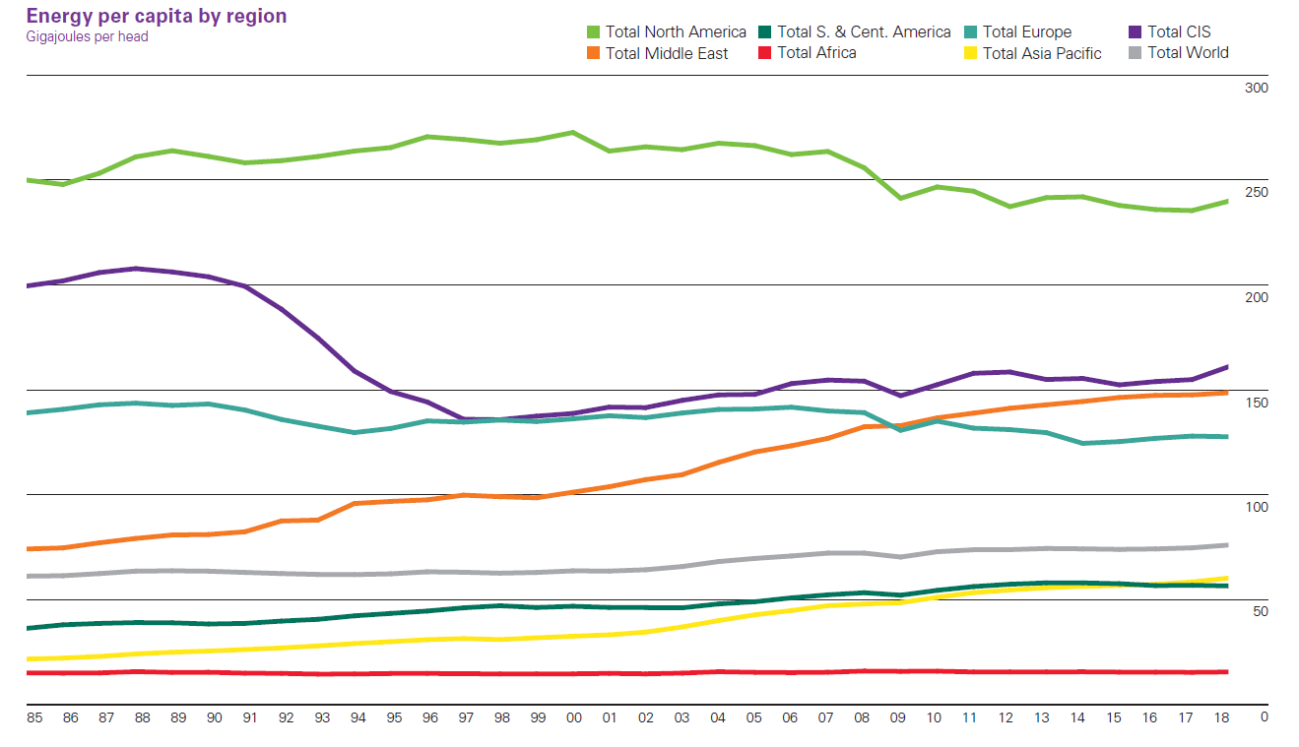
Per capita energy consumption
Source: BP Statistical Review of World Energy

Slide 4
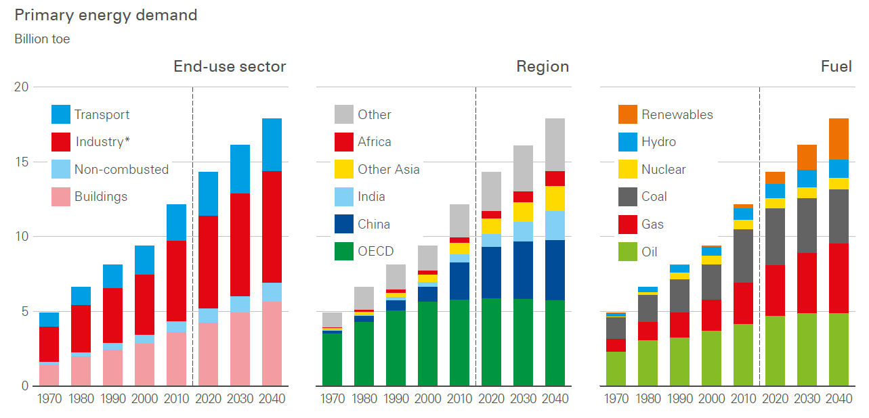
Energy consumption by region and fuel
Source: BP Energy outlook

Slide 5
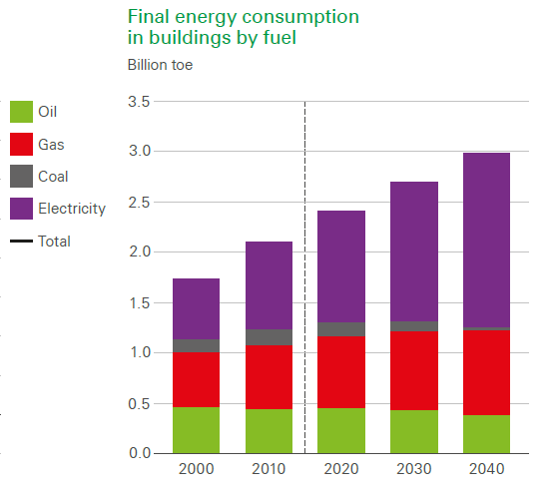
Energy use in buildings
Source: BP energy outlook

Slide 6
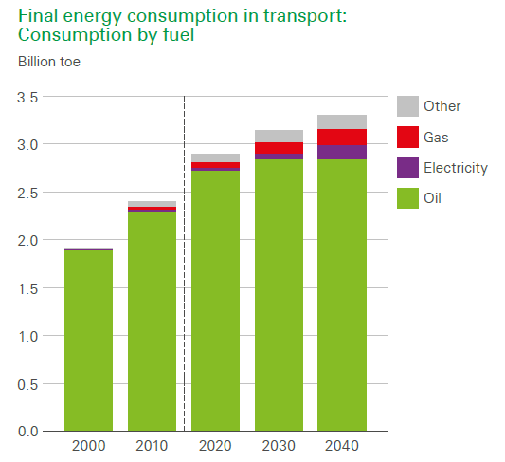
Energy use in transportation
Source: BP energy outlook

Slide 7
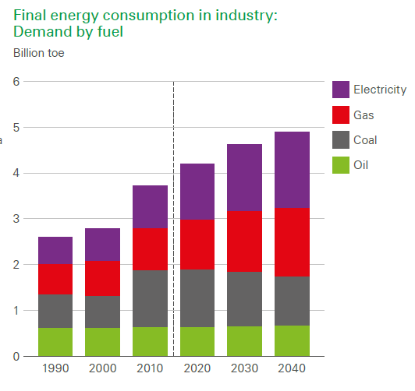
Energy use in industry
Source: BP energy outlook

Slide 8
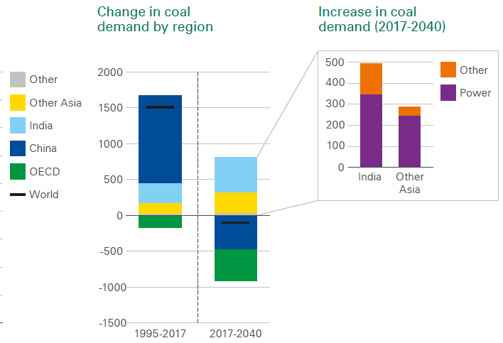
Demand for coal
Source: BP energy outlook

Slide 9
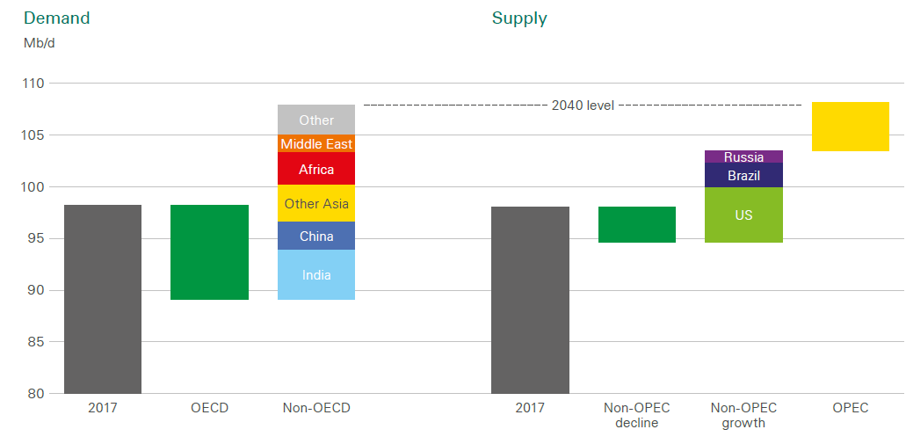
Oil supply and demand
Source: BP energy outlook

Slide 10
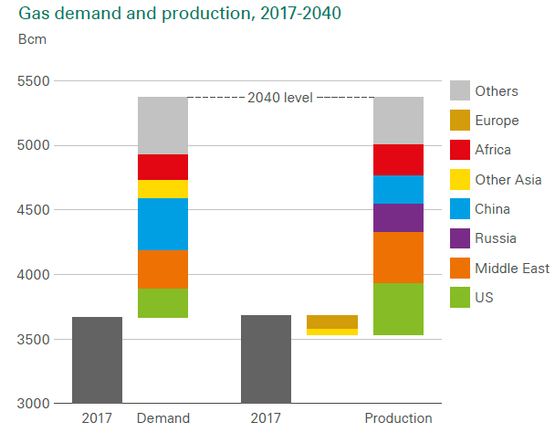
Gas supply and demand
Source: BP energy outlook

Slide 11
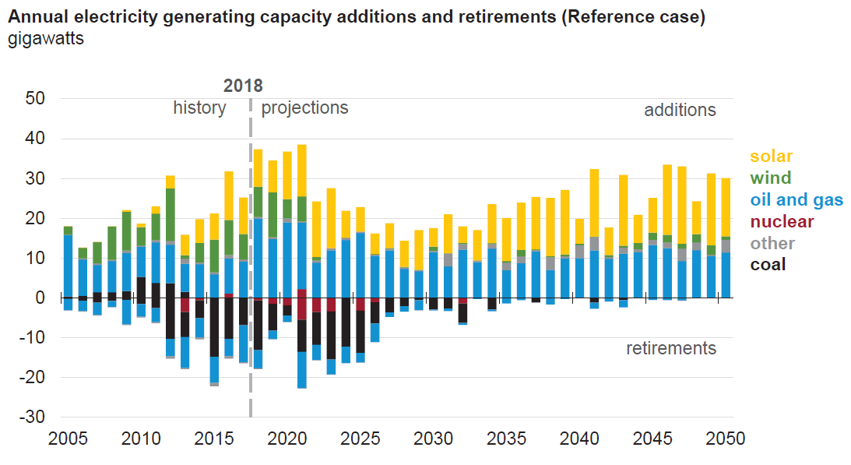
Fuel shares in the world: new plants
New additions to power production capacity have mostly been in solar and gas power generations.
Source: EIA

Slide 12
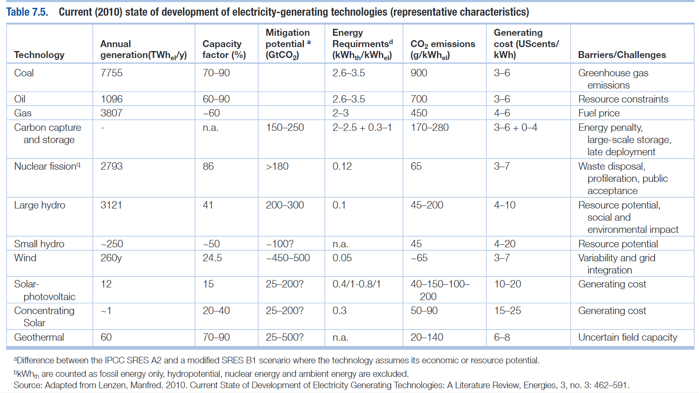
Electricity generating technologies
Many factors should be considered in choosing a technology.
Source: Morris and Cleveland

Slide 13
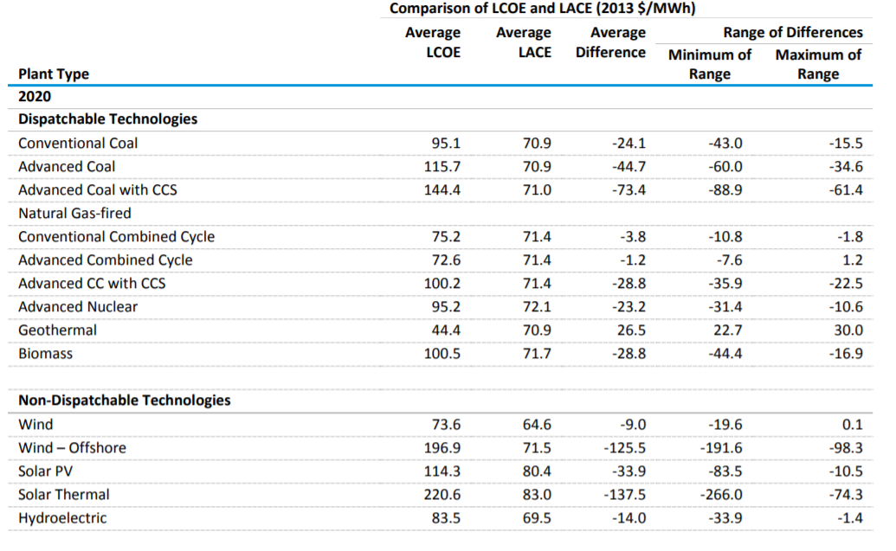
LCOE (cost) and LACE (value)
Source: EIA

Slide 14
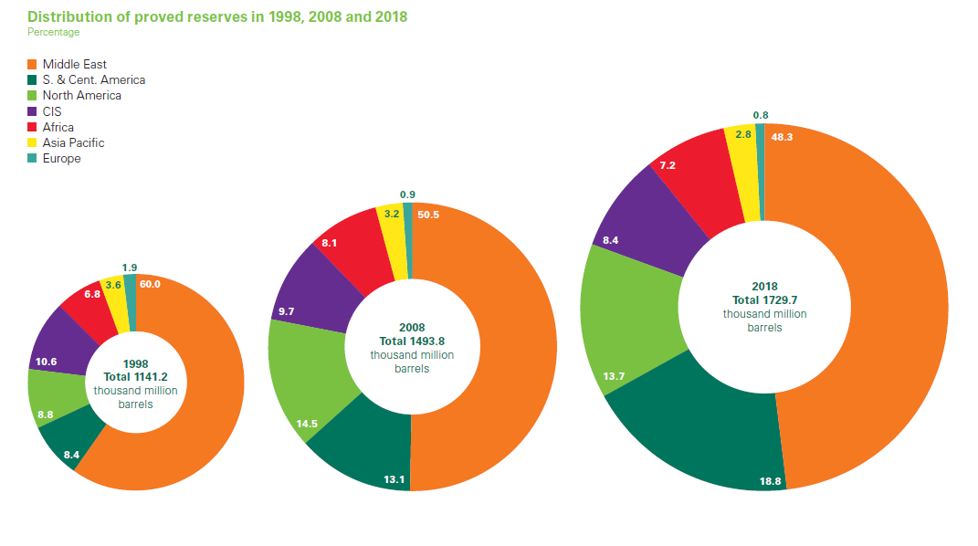
Oil reserves
Source: BP Statistical Review of World Energy

Slide 15
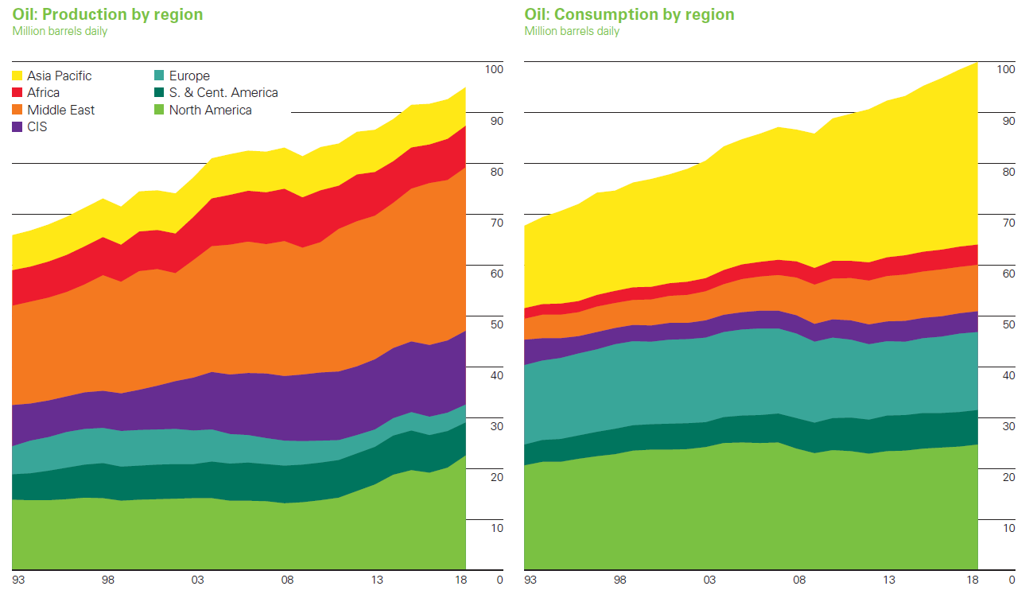
Oil production/consumption
Source: BP Statistical Review of World Energy

Slide 16
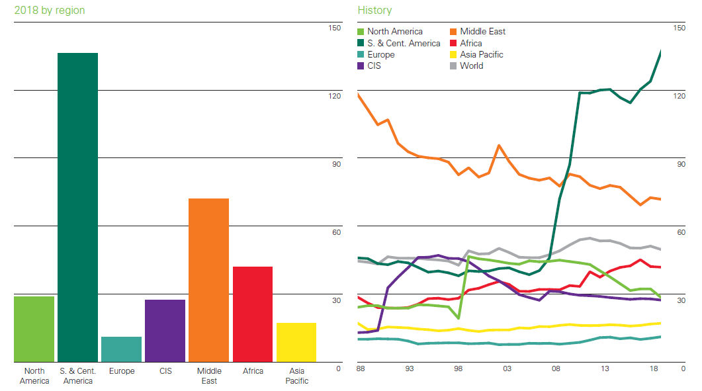
Oil reserves to production
Reserve to production is large in South and Central America, followed by Middle East.
Source: BP

Slide 17
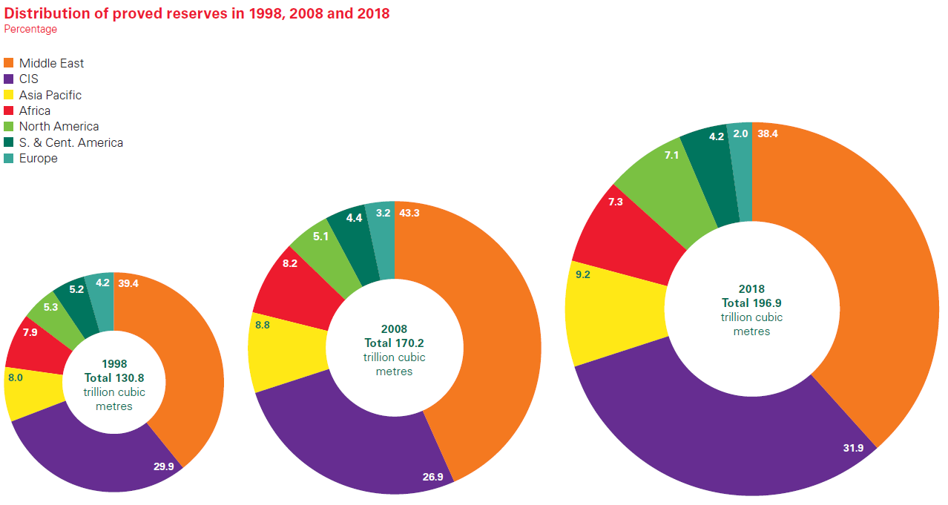
Gas reserves
Source: BP Statistical Review of World Energy

Slide 18
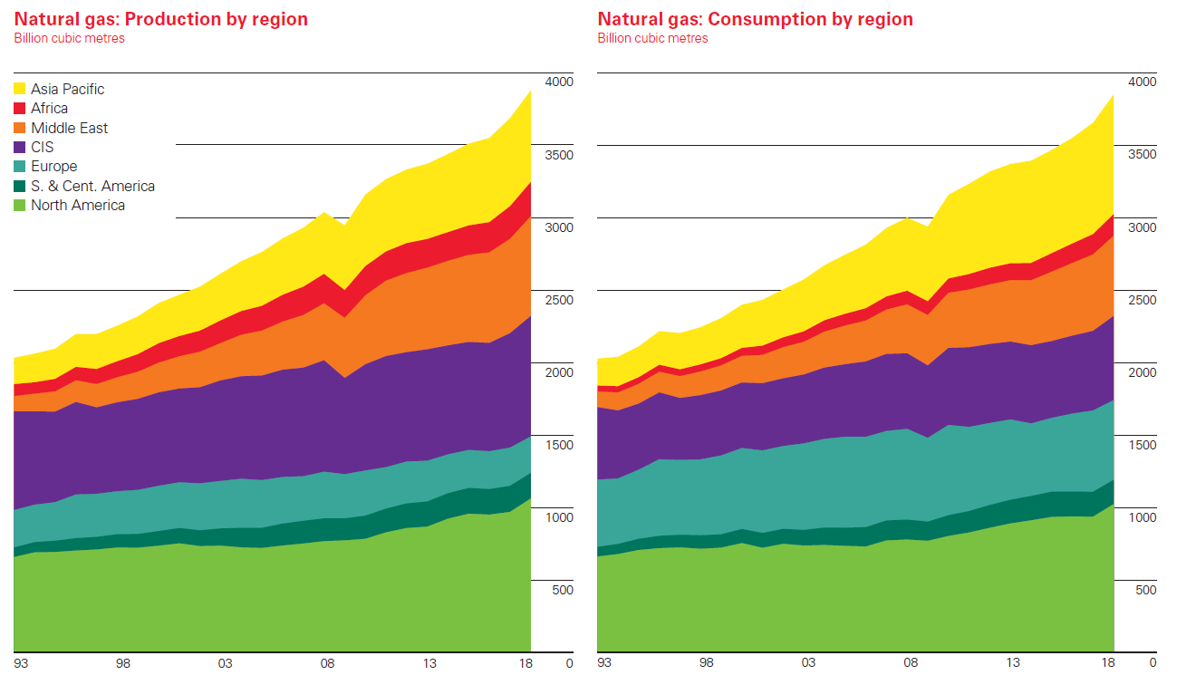
Gas production/consumption
Source: BP Statistical Review of World Energy

Slide 19
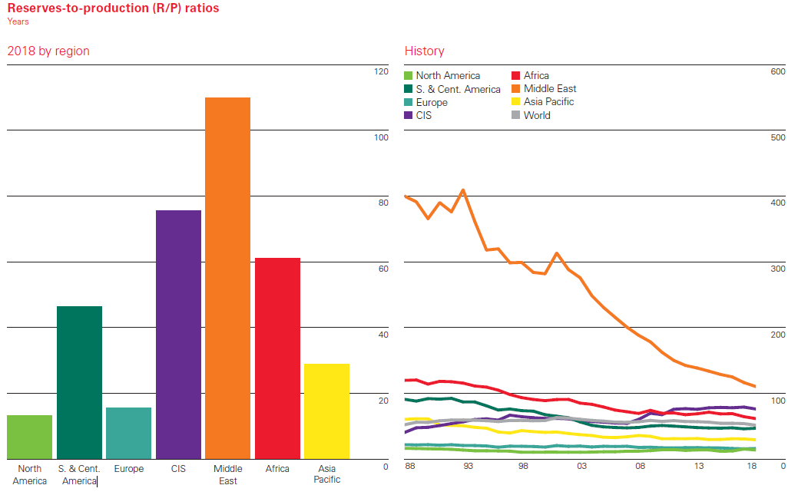
Natural gas reserves to production
Middle East and Central Asia and Russia have a high reserve to production too.
Source: BP

Slide 20
Gas reserves/production/consumption
 | Reserves (1998) Bm3 | Reserves (2018)Bm3 | Share (%) | Production Bm3 | Res. to Pod. (years) | Consumption Bm3 | Cons./Prod.
Russia | 33,400 | 38,900 | 19.8 | 669.5 | 58.2 | 454.5 | 67.9
Iran | 22,800 | 31,900 | 16.2 | 239.5 | 133.3 | 225.6 | 94.2
Qatar | 11,300 | 24,700 | 12.5 | 175.5 | 140.7 | 41.9 | 23.9
Turkmenistan | 2,500 | 19,500 | 9.9 | 61.5 | 316.8 | 28.4 | 46.2
United States | 4,400 | 11,900 | 6 | 832.0 | 14.3 | 817.5 | 98.3
World | 130,800 | 196,900 | 100 | 3,867.9 | 50.9 | 3848.9 | 99.5
Source: BP Statistical Review of World Energy

Slide 21
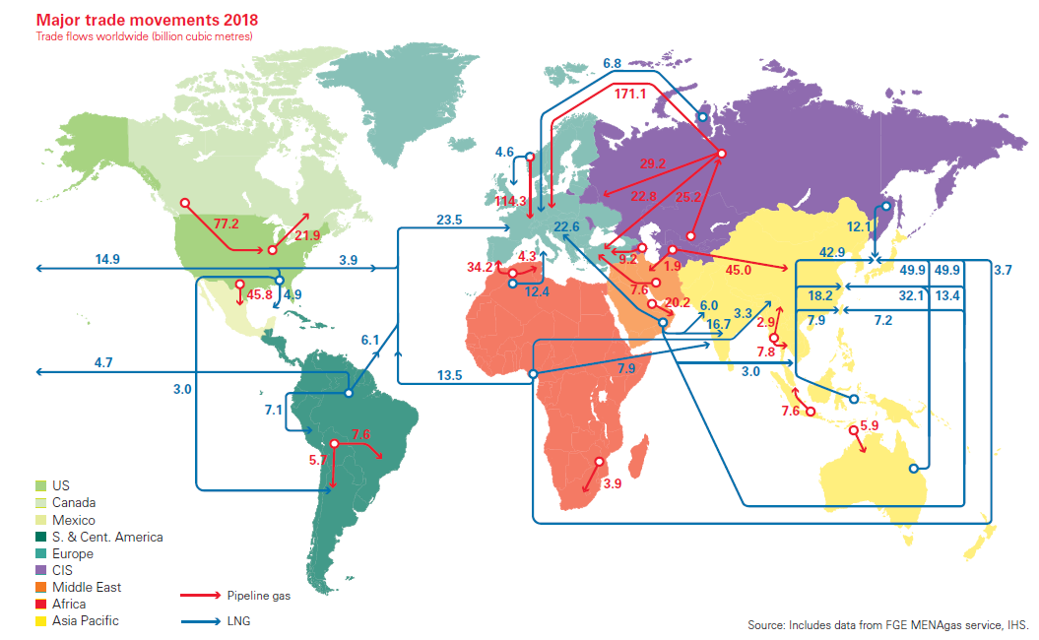
BP energy outlook

Slide 22
Natural gas market
Gas is different than oil!
Gas availability is more diversified.
It is more abundant than oil.
Its transportation is difficult and costly.
Delivering it to end user needs a huge fixed cost.
Its energy density is much less than oil.
Therefore:
  Gas markets are local markets
The markets form only if there is a critical mass of potential users.
Source: Bhattacharyya

Slide 23
Country level energy policy: Russia
One of the ways Russia promotes its policy of gaining leverage over its transit states is through buying up energy infrastructure in neighboring states.
Russia makes it a formal goal to acquire energy infrastructure in the former Soviet republics.
One of Russia’s major energy goals is retaining its role as the main exporter to the EU gas market.
Moscow has gone to great lengths to ensure its predominance in the market, including investing in extremely expensive infrastructure that circumvents transit states, and purchasing routes that could allow potential competitors, such as Turkmenistan and Iran, to enter the European market directly.
Source: Energy Politics

Slide 24
Pipeline politics: India
India′s energy situation is characterized by:
  increasing energy demand,
  high fossil fuel dependency,
  large import shares,
  significant portion of population deprived of modern energy services.
Natural gas, being the cleanest fossil fuel with high efficiency and cost effectiveness, is expected to play an important role.
India, with only 0.6% of proven world reserves, is not endowed with adequate natural gas domestically.
There are gas reserves in neighbouring regions which gives rise to the prospects of three cross border gas pipeline projects.
Source: Nathan, 2013

Slide 25
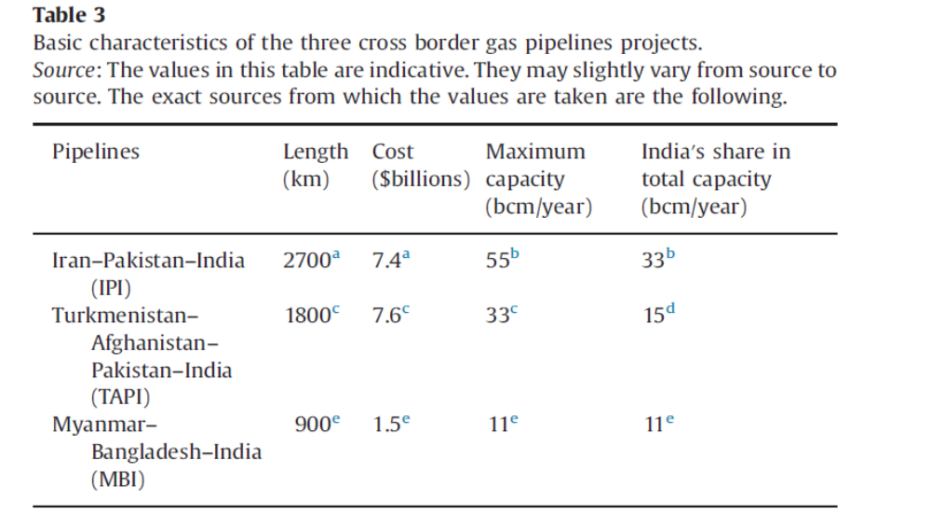
Pipeline politics: India
There are three possible pipeline projects. Each has advantages and disadvantages.
Source: Nathan, 2013

Slide 26
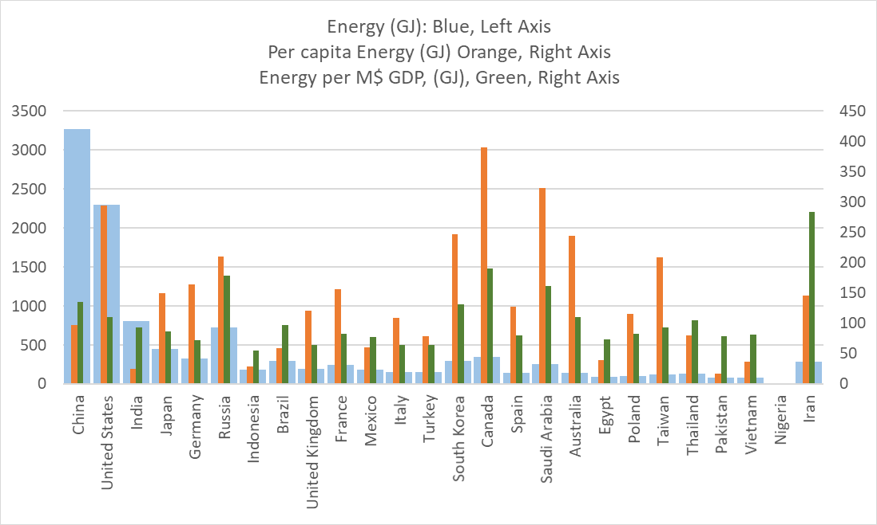
Energy consumption, ranked by GDP (PPP)
Source: BP Statistical Review of World Energy

Slide 27
What is the story?
Gas is the future of energy.
Iran has gas, a lot of it!
Iran produces gas, a lot of it!
Iran uses gas, a lot of it!
Russia intends to prevent competition.
India is looking for gas.
Iran is not engaged in the world gas market.

